Slide 1

Database Systems:
Design, Implementation, and Management
Tenth Edition
Chapter 10
Transaction Management
and Concurrency Control

Slide 2
Objectives
In this chapter, you will learn:
  About database transactions and their properties
  What concurrency control is and what role it plays in maintaining the database’s integrity
  What locking methods are and how they work
Database Systems, 10th Edition

Slide 3
Objectives (cont’d.)
  How stamping methods are used for concurrency control
  How optimistic methods are used for concurrency control
  How database recovery management is used to maintain database integrity
Database Systems, 10th Edition

Slide 4
What Is a Transaction?
Logical unit of work that must be either entirely completed or aborted
Successful transaction changes database from one consistent state to another
  One in which all data integrity constraints are satisfied
Most real-world database transactions are formed by two or more database requests
  Equivalent of a single SQL statement in an application program or transaction
Database Systems, 10th Edition

Slide 5
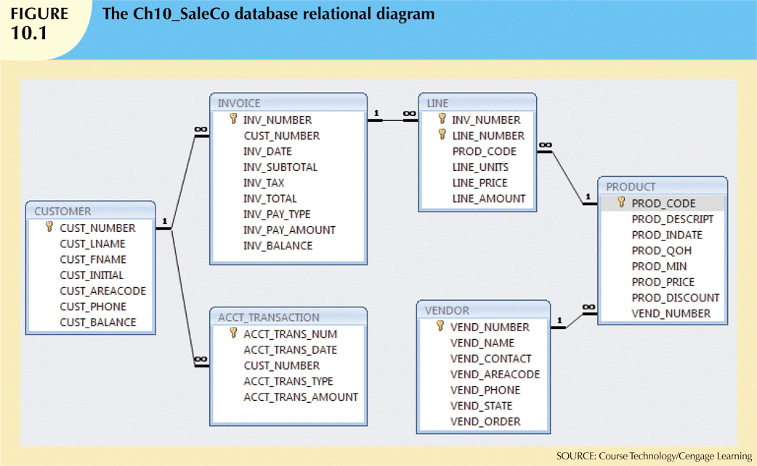
Database Systems, 10th Edition

Slide 6
Evaluating Transaction Results
Not all transactions update database
SQL code represents a transaction because database was accessed
Improper or incomplete transactions can have devastating effect on database integrity
  Some DBMSs provide means by which user can define enforceable constraints
  Other integrity rules are enforced automatically by the DBMS
Database Systems, 10th Edition

Slide 7
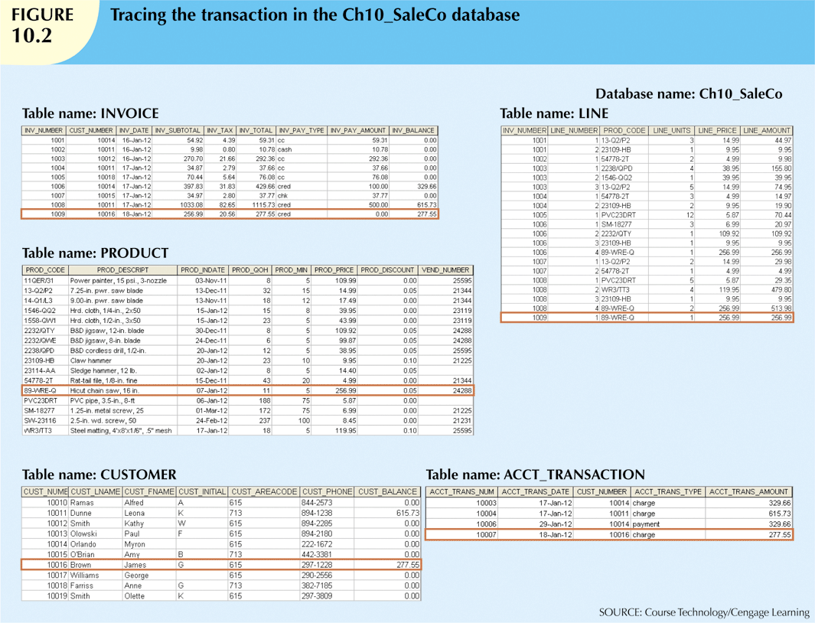
Figure 9.2
Database Systems, 10th Edition

Slide 8
Transaction Properties
Atomicity
  All operations of a transaction must be completed
Consistency
  Permanence of database’s consistent state
Isolation
  Data used during transaction cannot be used by second transaction until the first is completed
Database Systems, 10th Edition

Slide 9
Transaction Properties (cont’d.)
Durability
  Once transactions are committed, they cannot be undone
Serializability
  Concurrent execution of several transactions yields consistent results
Multiuser databases are subject to multiple concurrent transactions
Database Systems, 10th Edition

Slide 10
Transaction Management with SQL
ANSI has defined standards that govern SQL database transactions
Transaction support is provided by two SQL statements: COMMIT and ROLLBACK
Transaction sequence must continue until:
  COMMIT statement is reached
  ROLLBACK statement is reached
  End of program is reached
  Program is abnormally terminated
Database Systems, 10th Edition

Slide 11
The Transaction Log
Transaction log stores:
  A record for the beginning of transaction
  For each transaction component:
    Type of operation being performed (update, delete, insert)
    Names of objects affected by transaction
    “Before” and “after” values for updated fields
    Pointers to previous and next transaction log entries for the same transaction
  Ending (COMMIT) of the transaction
Database Systems, 10th Edition

Slide 12
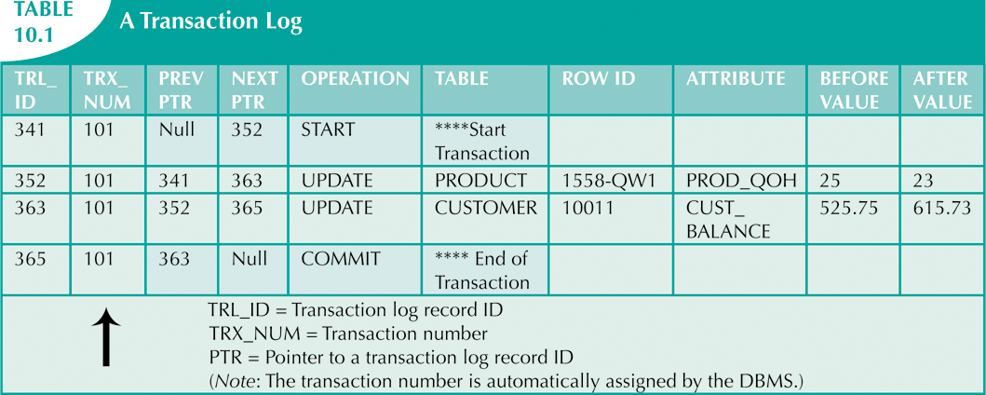
Database Systems, 10th Edition

Slide 13
Concurrency Control
Coordination of simultaneous transaction execution in a multiprocessing database
Objective is to ensure serializability of transactions in a multiuser environment
Three main problems:
  Lost updates
  Uncommitted data
  Inconsistent retrievals
Database Systems, 10th Edition

Slide 14
Lost Updates
Lost update problem:
  Two concurrent transactions update same data element
  One of the updates is lost
    Overwritten by the other transaction
Database Systems, 10th Edition

Slide 15
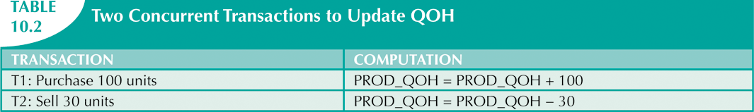
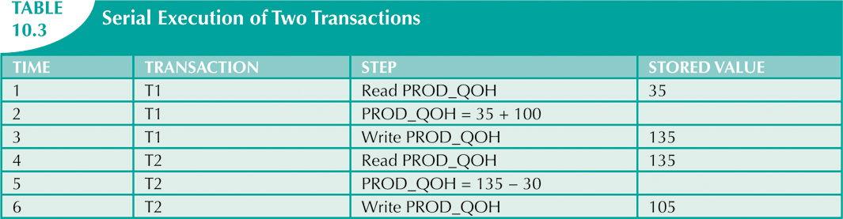
Database Systems, 10th Edition

Slide 16
Uncommitted Data
Uncommitted data phenomenon:
  Two transactions are executed concurrently
  First transaction rolled back after second already accessed uncommitted data
Database Systems, 10th Edition

Slide 17
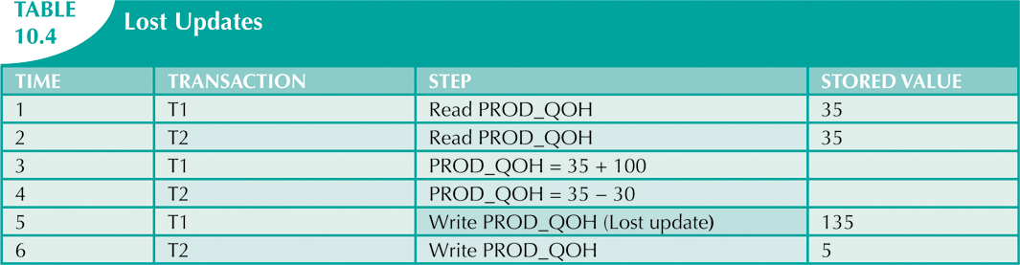
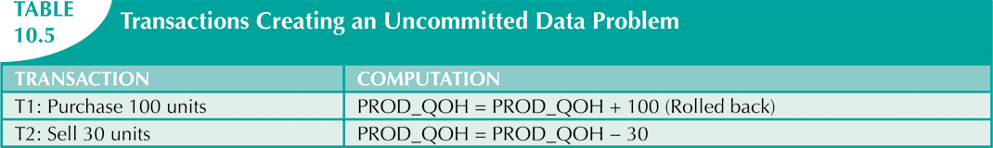
Database Systems, 10th Edition

Slide 18
Inconsistent Retrievals
Inconsistent retrievals:
  First transaction accesses data
  Second transaction alters the data
  First transaction accesses the data again
Transaction might read some data before they are changed and other data after changed
Yields inconsistent results
Database Systems, 10th Edition

Slide 19
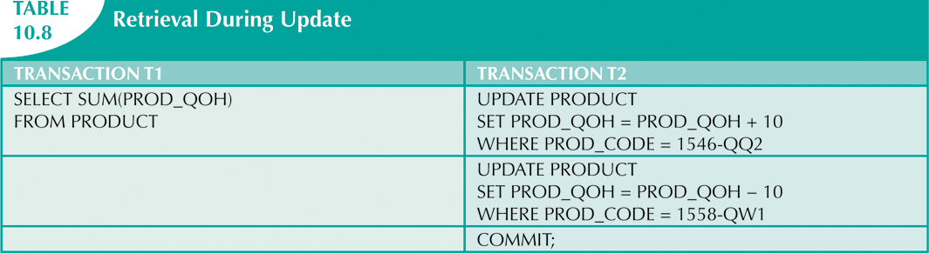
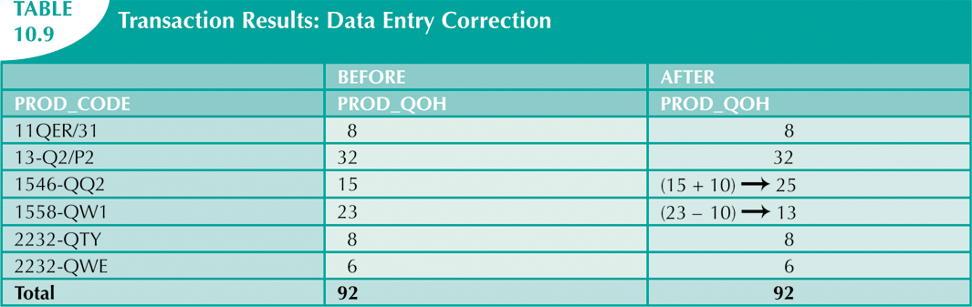
Database Systems, 10th Edition

Slide 20
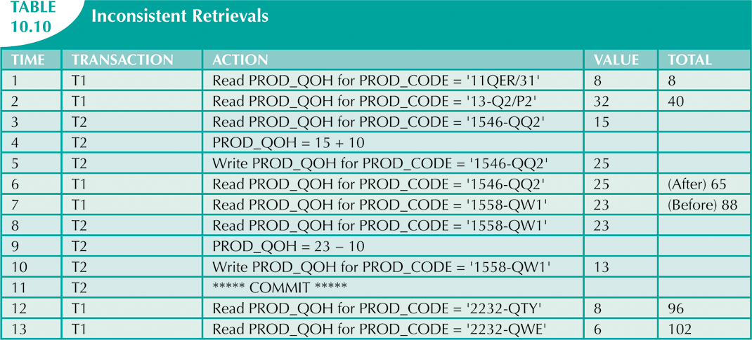
Database Systems, 10th Edition

Slide 21
The Scheduler
Special DBMS program
  Purpose is to establish order of operations within which concurrent transactions are executed
Interleaves execution of database operations:
  Ensures serializability
  Ensures isolation
Serializable schedule
  Interleaved execution of transactions yields same results as serial execution
Database Systems, 10th Edition

Slide 22
Concurrency Control with Locking Methods
Lock
  Guarantees exclusive use of a data item to a current transaction
  Required to prevent another transaction from reading inconsistent data
  Pessimistic locking
    Use of locks based on the assumption that conflict between transactions is likely
  Lock manager
    Responsible for assigning and policing the locks used by transactions
Database Systems, 10th Edition

Slide 23
Lock Granularity
Indicates level of lock use
Locking can take place at following levels:
  Database
  Table
  Page
  Row
  Field (attribute)
Database Systems, 10th Edition

Slide 24
Lock Granularity (cont’d.)
Database-level lock
  Entire database is locked
Table-level lock
  Entire table is locked
Page-level lock
  Entire diskpage is locked
Database Systems, 10th Edition

Slide 25
Lock Granularity (cont’d.)
Row-level lock
  Allows concurrent transactions to access different rows of same table
    Even if rows are located on same page
Field-level lock
  Allows concurrent transactions to access same row
    Requires use of different fields (attributes) within the row
Database Systems, 10th Edition

Slide 26
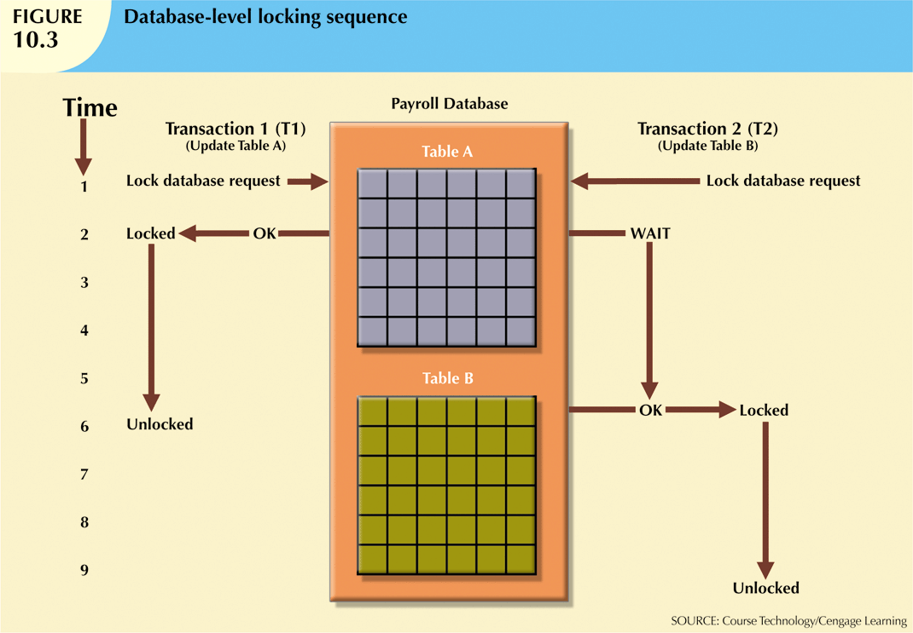
Database Systems, 10th Edition

Slide 27
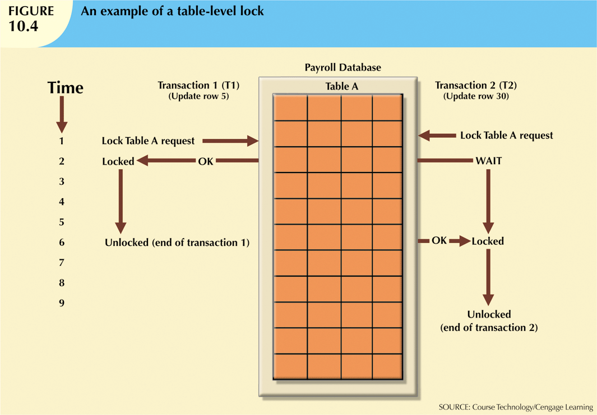
Database Systems, 10th Edition

Slide 28
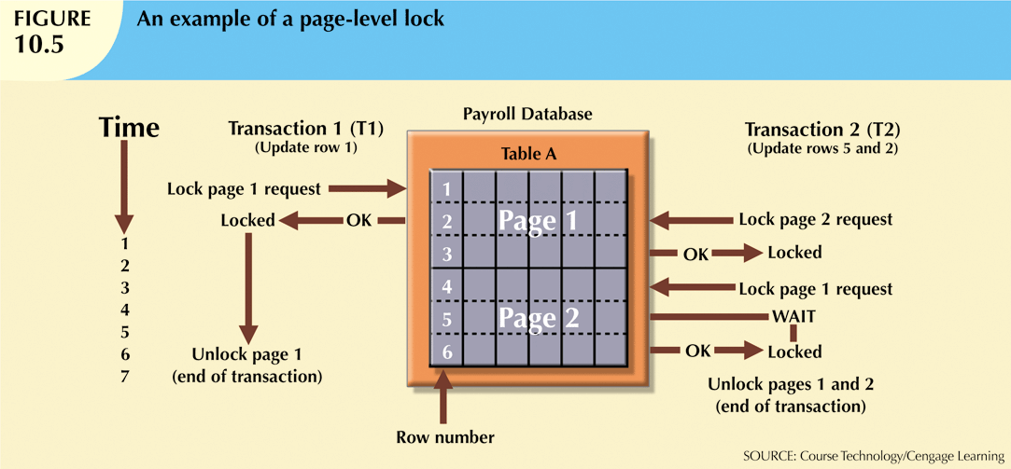
Database Systems, 10th Edition

Slide 29
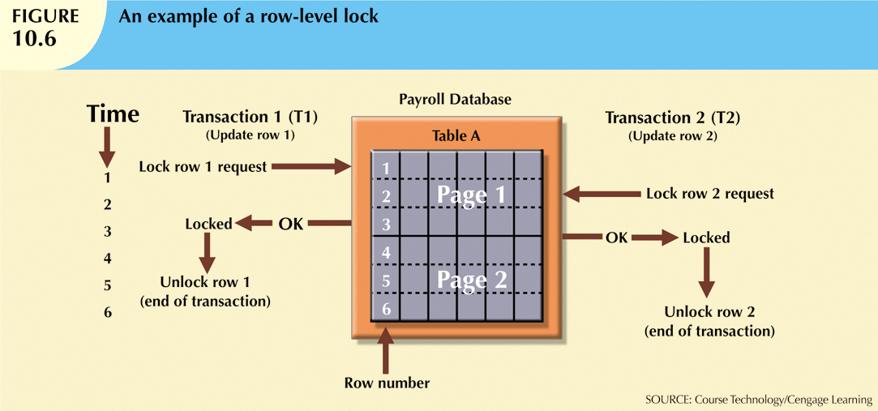
Database Systems, 10th Edition

Slide 30
Lock Types
Binary lock
  Two states: locked (1) or unlocked (0)
Exclusive lock
  Access is specifically reserved for transaction that locked object
  Must be used when potential for conflict exists
Shared lock
  Concurrent transactions are granted read access on basis of a common lock
Database Systems, 10th Edition

Slide 31
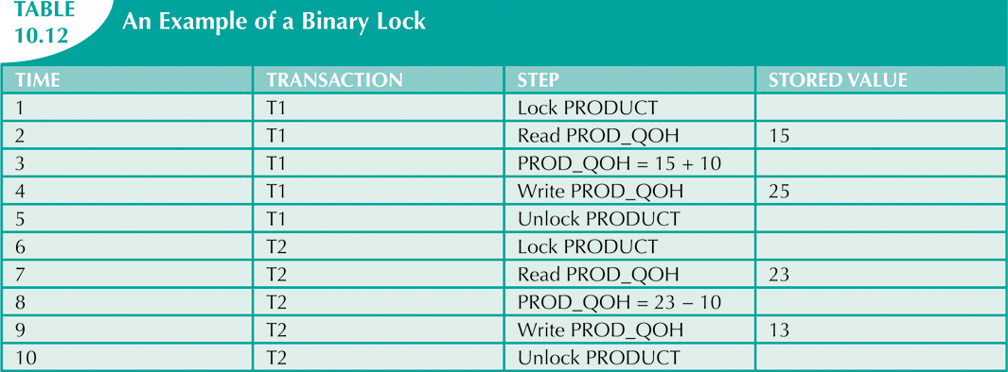
Database Systems, 10th Edition

Slide 32
Two-Phase Locking to Ensure Serializability
Defines how transactions acquire and relinquish locks
Guarantees serializability, but does not prevent deadlocks
  Growing phase
    Transaction acquires all required locks without unlocking any data
  Shrinking phase
    Transaction releases all locks and cannot obtain any new lock
Database Systems, 10th Edition

Slide 33
Two-Phase Locking to Ensure Serializability (cont’d.)
Governed by the following rules:
  Two transactions cannot have conflicting locks
  No unlock operation can precede a lock operation in the same transaction
  No data are affected until all locks are obtained
Database Systems, 10th Edition

Slide 34
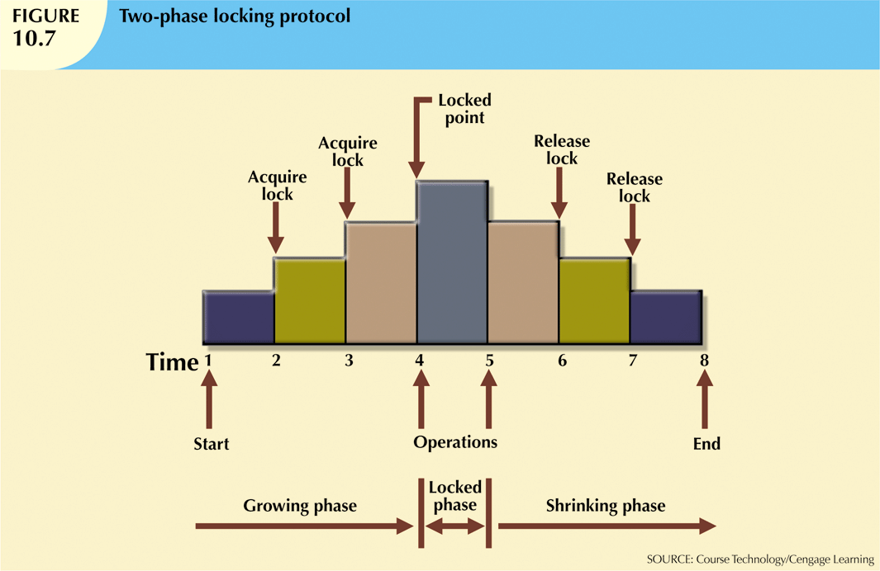
Database Systems, 10th Edition

Slide 35
Deadlocks
Condition that occurs when two transactions wait for each other to unlock data
Possible only if one of the transactions wants to obtain an exclusive lock on a data item
  No deadlock condition can exist among shared locks
Database Systems, 10th Edition

Slide 36
Deadlocks (cont’d.)
Three techniques to control deadlock:
  Prevention
  Detection
  Avoidance
Choice of deadlock control method depends on database environment
  Low probability of deadlock; detection recommended
  High probability; prevention recommended
Database Systems, 10th Edition

Slide 37
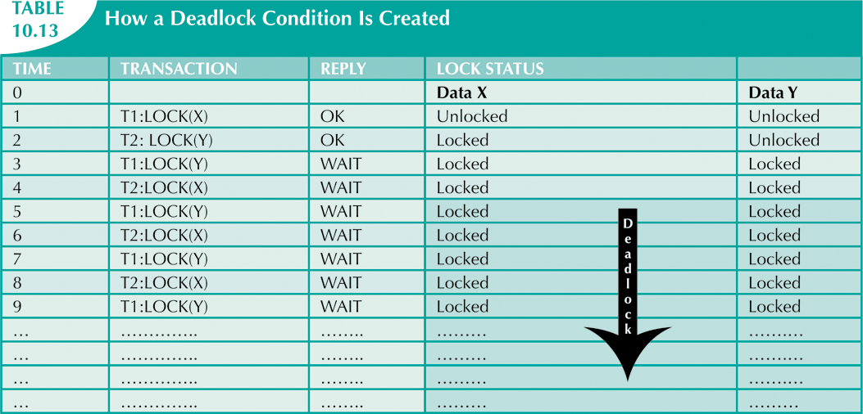
Database Systems, 10th Edition

Slide 38
Concurrency Control with Time Stamping Methods
Assigns global unique time stamp to each transaction
Produces explicit order in which transactions are submitted to DBMS
Uniqueness
  Ensures that no equal time stamp values can exist
Monotonicity
  Ensures that time stamp values always increase
Database Systems, 10th Edition

Slide 39
Wait/Die and Wound/Wait Schemes
Wait/die
  Older transaction waits and younger is rolled back and rescheduled
Wound/wait
  Older transaction rolls back younger transaction and reschedules it
Database Systems, 10th Edition

Slide 40
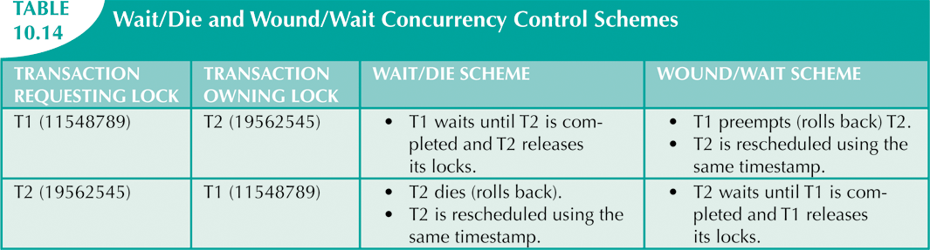
Database Systems, 10th Edition

Slide 41
Concurrency Control with Optimistic Methods
Optimistic approach
  Based on assumption that majority of database operations do not conflict
  Does not require locking or time stamping techniques
  Transaction is executed without restrictions until it is committed
  Phases: read, validation, and write
Database Systems, 10th Edition

Slide 42
Database Recovery Management
Restores database to previous consistent state
Based on atomic transaction property
  All portions of transaction are treated as single logical unit of work
  All operations are applied and completed to produce consistent database
If transaction operation cannot be completed:
  Transaction aborted
  Changes to database are rolled back
Database Systems, 10th Edition

Slide 43
Transaction Recovery
Write-ahead-log protocol: ensures transaction logs are written before data is updated
Redundant transaction logs: ensure physical disk failure will not impair ability to recover
Buffers: temporary storage areas in primary memory
Checkpoints: operations in which DBMS writes all its updated buffers to disk
Database Systems, 10th Edition

Slide 44
Transaction Recovery (cont’d.)
Deferred-write technique
  Only transaction log is updated
Recovery process: identify last checkpoint
  If transaction committed before checkpoint:
    Do nothing
  If transaction committed after checkpoint:
    Use transaction log to redo the transaction
  If transaction had ROLLBACK operation:
    Do nothing
Database Systems, 10th Edition

Slide 45
Transaction Recovery (cont’d.)
Write-through technique
  Database is immediately updated by transaction operations during transaction’s execution
Recovery process: identify last checkpoint
  If transaction committed before checkpoint:
    Do nothing
  If transaction committed after last checkpoint:
    DBMS redoes the transaction using “after” values
  If transaction had ROLLBACK or was left active:
    Do nothing because no updates were made
Database Systems, 10th Edition

Slide 46
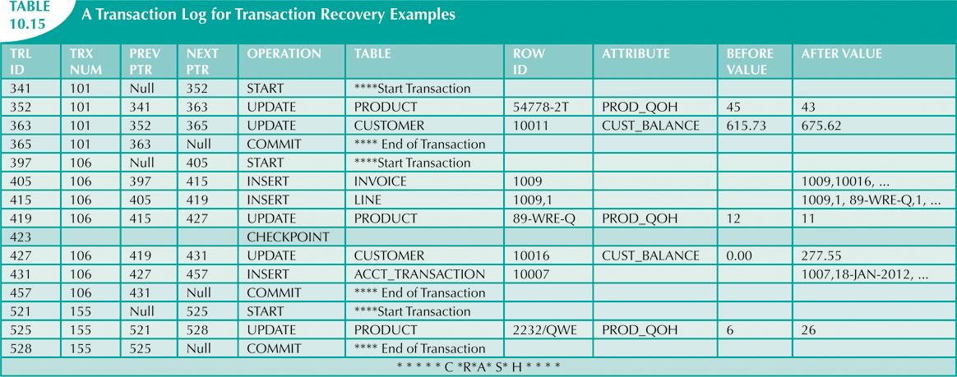
Database Systems, 10th Edition

Slide 47
Summary
Transaction: sequence of database operations that access database
  Logical unit of work
    No portion of transaction can exist by itself
  Five main properties: atomicity, consistency, isolation, durability, and serializability
COMMIT saves changes to disk
ROLLBACK restores previous database state
SQL transactions are formed by several SQL statements or database requests
Database Systems, 10th Edition

Slide 48
Summary (cont’d.)
Transaction log keeps track of all transactions that modify database
Concurrency control coordinates simultaneous execution of transactions
Scheduler establishes order in which concurrent transaction operations are executed
Lock guarantees unique access to a data item by transaction
Two types of locks: binary locks and shared/exclusive locks
Database Systems, 10th Edition

Slide 49
Summary (cont’d.)
Serializability of schedules is guaranteed through the use of two-phase locking
Deadlock: when two or more transactions wait indefinitely for each other to release lock
Three deadlock control techniques: prevention, detection, and avoidance
Time stamping methods assign unique time stamp to each transaction
  Schedules execution of conflicting transactions in time stamp order
Database Systems, 10th Edition

Slide 50
Summary (cont’d.)
Optimistic methods assume the majority of database transactions do not conflict
  Transactions are executed concurrently, using private copies of the data
Database recovery restores database from given state to previous consistent state
Database Systems, 10th Edition

